Slide 1
Database design and Applications CSIZG518/SEZG518/SSZG518)(S1-21) Uma Maheswari

Slide 2
Session 3
Topic : Relational model.

Slide 3
LEARNING OUTCOME
Relational model concepts
Relational data model constraints
REFER: T1-Chapter 5
Sections:
5.1- 5.3

Slide 4
Data Model and schema
The data model emphasizes on what data is needed and how it should be organized instead of what operations will be performed on data.
The data models are used to represent the data and how it is stored in the database and to set the relationship between data items.
Data Model is like an architect's building plan, which helps to build conceptual models and set a relationship between data items. So it is an abstract model that organizes data description, data semantics, and consistency constraints of data.
There are 3 different types of data models: conceptual data models, logical data models, and physical data models, and each one has a specific purpose.
1. Conceptual Data Model: This Data Model defines WHAT the system contains. This model is typically created by Business stakeholders and Data Architects. The purpose is to organize, scope and define business concepts and rules. This is a high level data model where we use ER , EER and UML to represent the business concepts and organize data.
Logical Data Model: Defines HOW the system should be implemented regardless of the DBMS. This model is typically created by Data Architects and Business Analysts. The purpose is to developed technical map of rules and data structures. Schema or relational schema is belonging to logical data model. Schema means a logical view.
Physical Data Model: This Data Model describes HOW the system will be implemented using a specific DBMS system. This model is typically created by DBA and developers. The purpose is actual implementation of the database. While table basically stored in files belong to physical data model.

Slide 5
Relational model concepts

Slide 6
ORIGINS OF RELATIONAL MODEL
British computer scientist (mathematician?) E.F. (Ted) Codd of IBM first proposed the relational data model.
. It is based upon the mathematical concepts of relations, set theory and predicate logic
The first commercial implementations of the relational model became available in the early 1980's
SQL/DS by IBM and Oracle DBMS
DB2 (IBM), Oracle, SQL Server (Microsoft), and PostgreSQL.
Notes:
in a seminal paper in 1970 (A Relational Model for Large Shared Data Banks, Communications of the ACM, June 1970), which led to a revolution in the field of database management
Codd, who died in 2003, went on to write extensively about the subject. As a result of his achievements, Codd was awarded the highest honor in computer science, the ACM Turing Award, in 1981.

Slide 7
Relational Model Concepts
The relational Model of Data is based on the concept of a Relation.
A Relation is a mathematical concept based on the ideas of sets.
The strength of the relational approach to data management comes from the formal foundation provided by the theory of relations.
The model was first proposed by Dr. E.F. Codd of IBM in 1970 in the following paper: "A Relational Model for Large Shared Data Banks," Communications of the ACM, June 1970.

Slide 8
Relational Model Concepts

Slide 9
Relational Model Concepts
Domain
Attribute
Tuple
Relation
Relational Schema
Relational Database

Slide 10
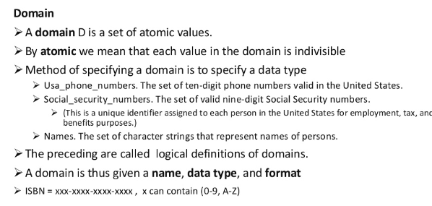
Relational Model Concepts
What is DOMAIN ?

Slide 11
Relational Model Concepts
What is DOMAIN ?
Examples of domains
USA_phone_number: string of digits of length ten
SSN: string of digits of length nine
Name: string of characters beginning with an upper case letter
GPA: a real number between 0.0 and 4.0
Sex: a member of the set { female, male }
Dept_Code: a member of the set { CMPS, MATH, ENGL, PHYS, PSYC, ... }
Notes:
For implementation purposes, it is necessary to provide descriptions of domains in terms of concrete data types (or formats) that are provided by the DBMS (such as String, int, boolean), in a manner analogous to how programming languages have intrinsic data types.

Slide 12
Relational Model Concepts
What is ATTRIBUTE?
Attribute: the name of the role played by some value (coming from
some domain) in the context of a relational schema.
The domain of attribute A is denoted dom(A).
An attribute designates the role played by the domain in that relation
eg.,
The domain Date may be used to define attributes “Invoice-date” and “Payment-date”.

Slide 13
Relational Model Concepts
What is a TUPLE?
Tuple: A tuple is a mapping from attributes to values drawn from the respective
domains of those attributes.
A tuple is intended to describe some entity (or relationship between entities) in
the miniworld.
example, a tuple for a PERSON entity might be
{ Name --> "Rumpelstiltskin", Sex --> Male, IQ --> 143 }

Slide 14
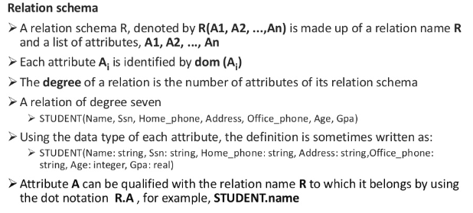
Relational Model Concepts
What is a RELATION SCHEMA?

Slide 15
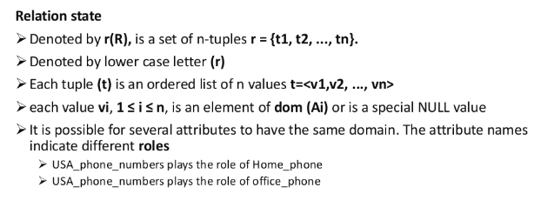
Relational Model Concepts
What is a RELATION SCHEMA?

Slide 16
Relational Model Concepts
What is a RELATION?
RELATION:
A (named) set of tuples all of the same form (i.e., having the same set of attributes). The term table is a loose synonym. (Some database purists would argue that a table is "only" a physical manifestation of a relation.)
Therefore relation (ie., relation state) is : r(R), a set of tuples. Each tuple is an ordered list of values, corresponding with the domain of their attribute, and representing a fact. A relation state is a subset of the Cartesian product of the domains defining the relation schema.
.Relational Database: A collection of relations, each one consistent with its
specified relational schema.

Slide 17
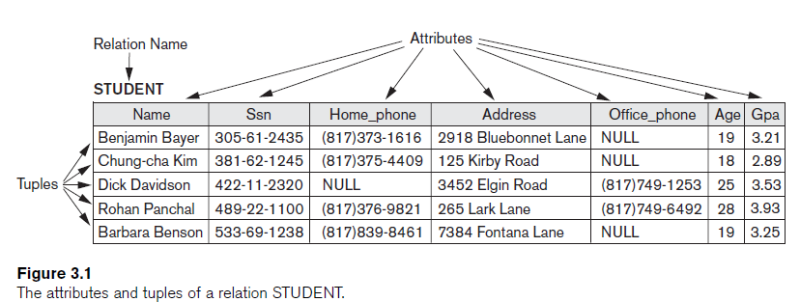

Slide 18
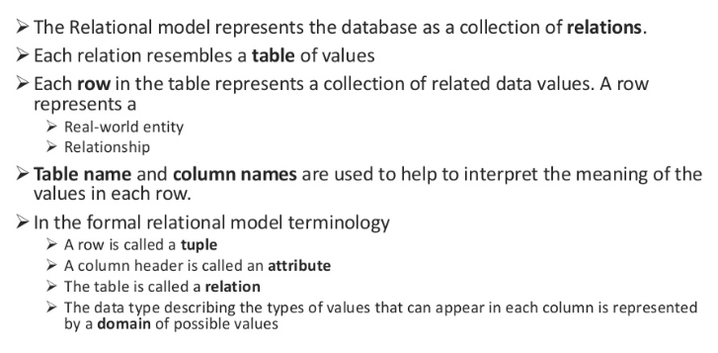
Relational Model Concepts

Slide 19
Characteristics of relations
a relation is a set – tuples are not in any order, and have no duplicates
flat relational model – values are atomic, not structures or lists
NULL (ω) – “information missing”, “not applicable”; ambiguous semantics, not a member of any domain
semantics of a relation – each tuple is an assertion of a true fact; sometimes confusing that this could be about an entity or a relationship; the schema can be interpreted as a predicate, each tuple is a list of values for which the predicate is true.

Slide 20
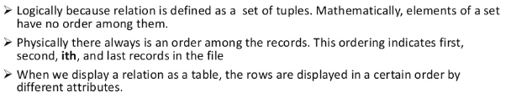
Characteristics of Relations ..contd
Ordering of Tuples:
A relation is a set of tuples; hence, there is no order associated with them.
Similarly, when tuples are represented on a storage device, they must be organized in some fashion, and it may be advantageous, from a performance standpoint, to organize them in a way that depends upon their content.

Slide 21
Characteristics of Relations ..contd
2. Ordering of Attributes:
A tuple is best viewed as a mapping from its attributes (i.e., the names we give to the roles played by the values comprising the tuple) to the corresponding values.
Hence, the order in which the attributes are listed in a table is irrelevant.
Note that, unfortunately, the set theoretic operations in relational algebra make implicit use of the order of the attributes.

Slide 22
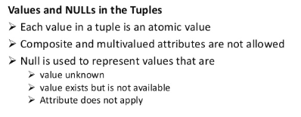
Characteristics of Relations ..contd
3. The Null value: used for don't know, not applicable or value undefined
4. Values of Attributes: For a relation to be in First Normal Form, each of its attribute domains must consist of atomic (neither composite nor multi-valued) values. Much of the theory underlying the relational model was based upon this assumption.
Multivalued attributes represented by separate relations and composite attributes as simple attributes in the basic relational model.

Slide 23
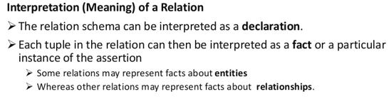
Characteristics of Relations ..contd
5. Interpretation of a Relation: Each relation can be viewed as a predicate and each tuple in that relation can be viewed as an assertion for which that predicate is satisfied (i.e., has value true) for the combination of values in it. In other words, each tuple represents a fact.
For say in eg., The first tuple listed means:
There exists a student having name Benjamin Bayer, having SSN 305-61-2435, having age 19, etc.
Keep in mind that some relations represent facts about entities (e.g., students) whereas others represent facts about relationships (between entities). (e.g., students and course sections).
.
6. The closed world assumption states that the only true facts about the miniworld are those represented by whatever tuples currently populate the database

Slide 24
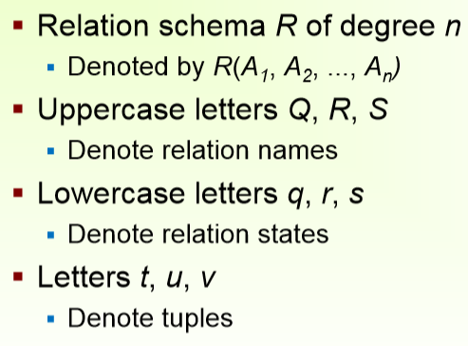
Notation

Slide 25
Notation
a relation name by itself refers to the current relation state, not the relation schema
dot notation can qualify an attribute name (like Q.a versus R.a) but all attributes in a schema must be uniquely named
An n-tuple t in a relation r(R) is denoted by t = <v1, v2, … , vn>, where vi is the value corresponding to attribute Ai.
The following notation refers to component values of tuples:
Both t[Ai] and t.Ai (and sometimes t[i]) refer to the value vi in t for attribute Ai.
Both t[Au, Aw, … , Az] and t.(Au, Aw, … , Az), where Au, Aw, … , Az is a list of attributes from R, refer to the subtuple of values from t corresponding to the attributes specified in the list
E.g., consider the tuple
t = <’Barbara Benson’, ‘533-69-1238’, ‘(817)839-8461’, ‘7384 Fontana Lane’, NULL, 19, 3.25>
from the STUDENT relation
we have t[Name] = <‘Barbara Benson’>, and t[Ssn, Gpa, Age] = <‘533-69-1238’, 3.25, 19>

Slide 26
Relational Model Concepts
The relation is formed over the cartesian product of the sets; each set has values from a domain; that domain is used in a specific role which is conveyed by the attribute name.
For example, attribute Cust-name is defined over the domain of strings of 25 characters. The role these strings play in the CUSTOMER relation is that of the name of customers.
Formally,
Given R(A₁, A₂, .........., A_{n})
r(R) ⊂ dom (A₁) X dom (A₂) X ....X dom(A_{n})
R: schema of the relation
r of R: a specific "value" or population of R.
R is also called the intension of a relation
r is also called the extension of a relation

Slide 27
Relational Model Concepts
Let S1 = {0,1}
Let S2 = {a,b,c}
Let R ⊂ S1 X S2
Then for example: r(R) = {<0,a> , <0,b> , <1,c> }
is one possible “state” or “population” or “extension” r of the relation R, defined over domains S1 and S2. It has three tuples.

Slide 28
Relational Model Concepts
DEFINITION SUMMARY
Informal Terms |  | Formal Terms
Table |  | Relation
Column |  | Attribute/Domain
Row |  | Tuple
Values in a column |  | Domain
Table Definition |  | Schema of a Relation
Populated Table |  | Extension

Slide 29
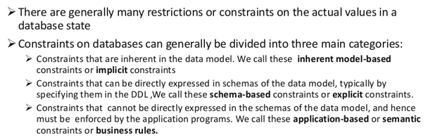
Relational Model Constraints
inherent model-based or implicit constraints: Example: no two tuples in a relation can be duplicates (because a relation is a set of tuples)

Slide 30
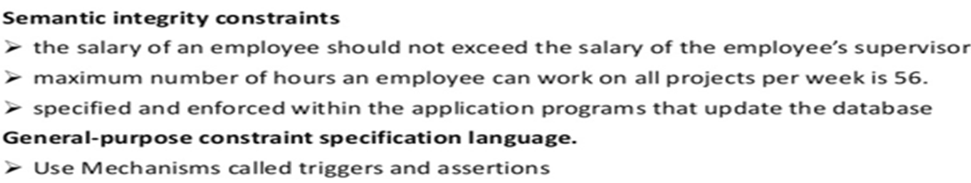
Semantic Integrity Constraints:
based on application semantics and cannot be expressed by the model per se
E.g., “the max. no. of hours per employee for all projects he or she works on is 56 hrs per week”
application-specific restrictions that are unlikely to be expressible in DDL.
Examples:
salary of a supervisee cannot be greater than that of her/his supervisor
salary of an employee cannot be lowered
A constraint specification language may have to be used to express these
SQL-99 allows triggers and ASSERTIONS to allow for some of these

Slide 31
1. Explicit or Schema-based constraints
Constraints are conditions that must hold on all valid relation instances.
There are three main types of constraints:
Key constraints
Entity integrity constraints
Referential integrity constraints

Slide 32
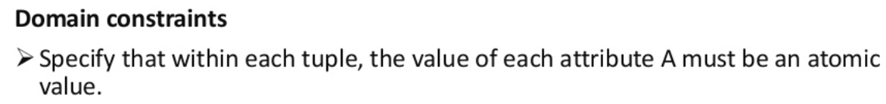
a. Key constraints
Each attribute value must be either null (which is really a non-value) or drawn from the domain of that attribute. Note that some DBMS's allow you to impose the not null constraint upon an attribute, which is to say that attribute.

Slide 33
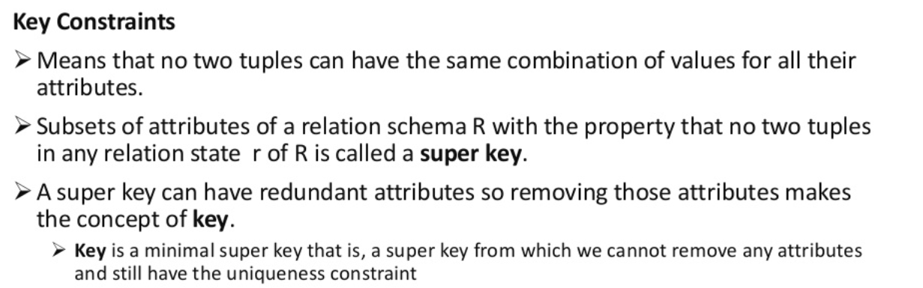
a. Key constraints
for any two distinct tuples t1 and t2 in a relation state r of R, we have the constraint that:
t1[SK] ≠ t2[SK]

Slide 34
a. Key constraints
Superkey of R: A set of attributes SK of R such that no two tuples in any valid relation instance r(R) will have the same value for SK. That is, for any distinct tuples t1 and t2 in r(R), t1[SK] ≠ t2[SK].
If a relation has several candidate keys, one is chosen arbitrarily to be the primary key.
The primary key attributes are underlined.
Notes:
that is, a superkey from which we cannot remove any attributes and still have the uniqueness constraint in hold. This property is not required by a superkey
key with multiple attributes must require all its attributes together to have the uniqueness property.
The value of a key attribute can be used to identify uniquely.

Slide 35
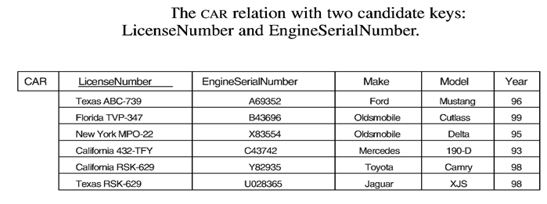
a. Key constraints
Key of R: A "minimal" superkey; that is, a superkey K such that removal of any attribute from K results in a set of attributes that is not a superkey.
Example: The CAR relation schema:
CAR(license#, EngineSerialNo, Make, Model, Year)
has two keys
Key1 = {License#},
Key2 = {EngineSerial#},
which are also superkeys.
{EngineSerial#, Make} is a superkey but not a key.

Slide 36
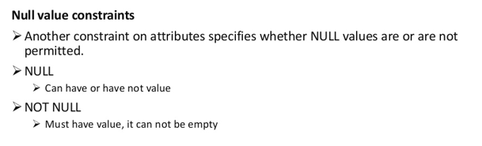
a. Key Constraints

Slide 37
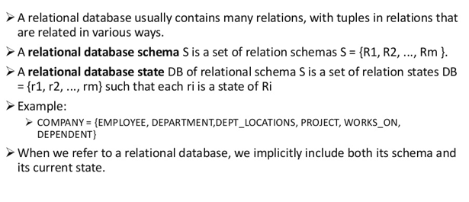
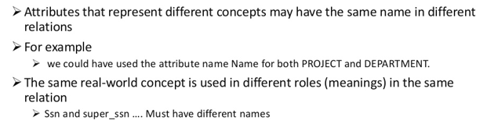
Relational DB and Relational DB Schema

Slide 38
Relational DB and Relational DB Schema
A relational database schema S is a set of relation schemas S = {R1, R2, … , Rm} and a set of integrity constraints IC.
A relational database state DB of S is a set of relation states
DB = {r1, r2, … , rm} such that each ri is a state of Ri and such that the
ri relation states satisfy the integrity constraints specified in IC.
Note : relational database state is sometimes called a relational database snapshot or instance
E.g., A relational database schema that we call COMPANY = {EMPLOYEE, DEPARTMENT, DEPT_LOCATIONS, PROJECT, WORKS_ON, DEPENDENT}.
When we refer to a relational database, we implicitly include both its schema and its current state. A database state that does not obey all the integrity constraints is called not valid, and a state that satisfies all the constraints in the defined set of integrity constraints IC is called a valid state
What is populating a DB?

Slide 39
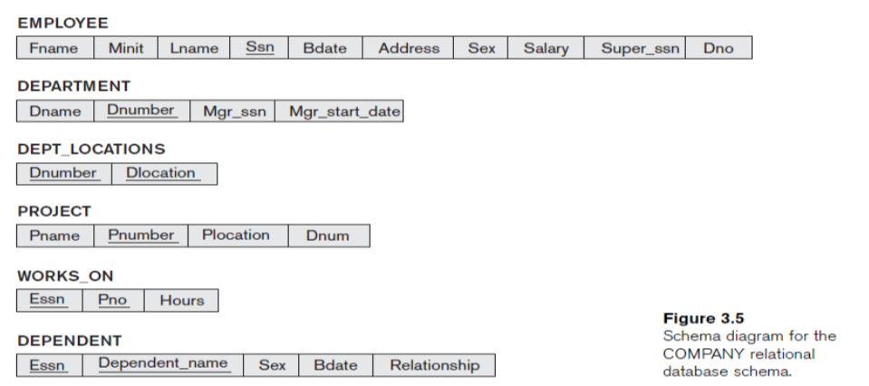
Relational DB and Relational DB Schemas

Slide 40
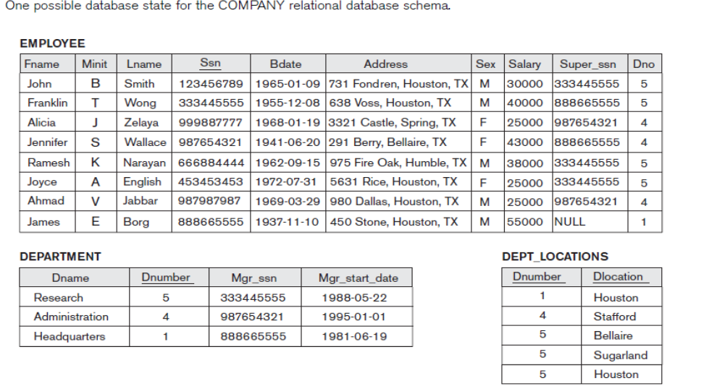
Relational DB and Relational DB Schemas

Slide 41
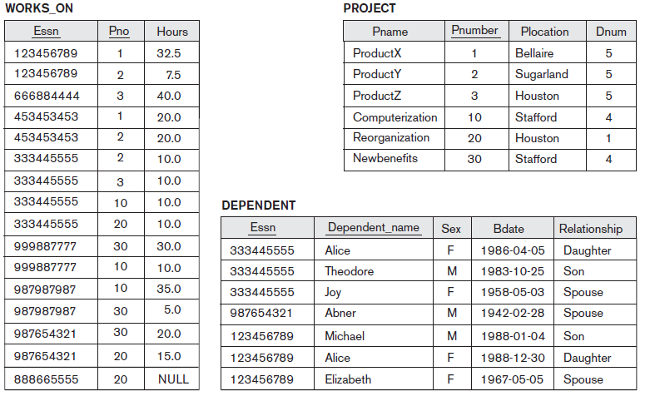
One possible database state for the COMPANY relational database schema.

Slide 42
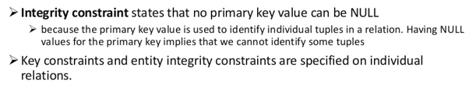
b. Entity Integrity or Integrity constraint
Relational Database Schema: A set S of relation schemas that belong to the same database. S is the name of the database.
S = {R₁, R₂, ..., R_{n}}
Entity Integrity: The primary key attributes PK of each relation schema R in S cannot have null values in any tuple of r(R). This is because primary key values are used to identify the individual tuples.
t[PK] ≠ null for any tuple t in r(R)
Note: Other attributes of R may be similarly constrained to disallow null values, even though they are not members of the primary key.

Slide 43
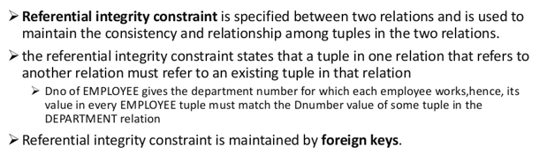
c. Referential Integrity constraint
What is a Weak entity ? How to fix it?

Slide 44
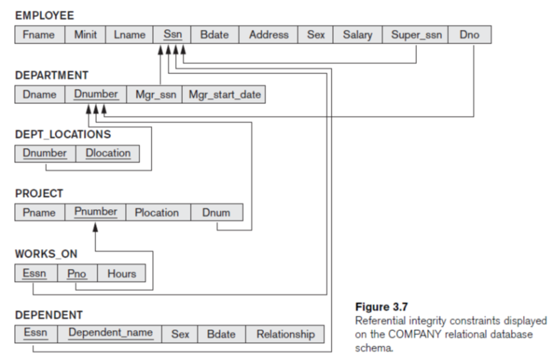
Relations together with a set of integrity constraints.

Slide 45
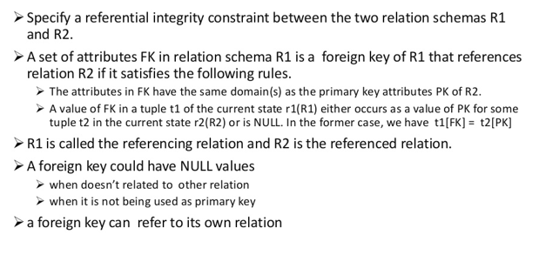
Foreign Key in RI constraint

Slide 46
Referential Integrity Constraint
Statement of the constraint
The value in the foreign key column (or columns) FK of the the referencing relation R₁ can be either:
(1) a value of an existing primary key value of the corresponding
primary key PK in the referenced relation R_{2,}, or..
(2) a null.
In case (2), the FK in R₁ should not be a part of its own primary key.

Slide 47
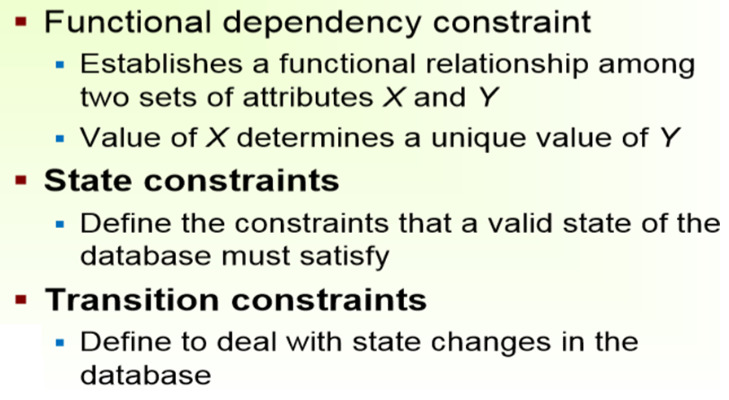
Other Constraints
An example of a transition constraint is:
“the salary of an employee can only increase.”
Such constraints are typically enforced by the application programs or specified using active rules and triggers,

Slide 48
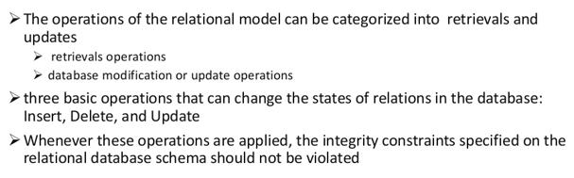
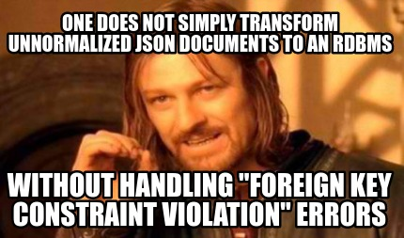
Operations and Constraint violation
We now see how violations happens
INSERT a tuple.
DELETE a tuple.
MODIFY/Update a tuple.

Slide 49
Update /Modify Operations and constraint violations on Relations

Slide 50
Update Operations on Relations
How violations can be prevented
Integrity constraints should not be violated by the update operations.
Several update operations may have to be grouped together.
Updates may propagate to cause other updates automatically. This may be necessary to maintain integrity constraints.

Slide 51
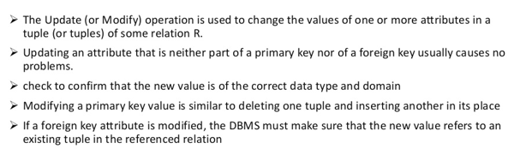
Constraint Violation on Update Operation

Slide 52
Update or modify operation
Key constraint violation: primary key is changed so as to become same as another tuple's.
referential integrity violation:
foreign key is changed and new one refers to nonexistent tuple
primary key is changed and now other tuples that had referred to this one violate the constraint

Slide 53
Update Operations on Relations
In case of integrity violation, several actions can be taken:
Cancel the operation that causes the violation (REJECT option)
Perform the operation but inform the user of the violation
Trigger additional updates so the violation is corrected (CASCADE option, SET NULL option)
Execute a user-specified error-correction routine

Slide 54
Update Operations on Relations and violations
■ Operation:
Update the salary of the EMPLOYEE tuple with Ssn = ‘999887777’ to 28000.
Result: Acceptable.
■ Operation:
Update the Dno of the EMPLOYEE tuple with Ssn = ‘999887777’ to 1.
Result: Acceptable.
■ Operation:
Update the Dno of the EMPLOYEE tuple with Ssn = ‘999887777’ to 7.
Result: Unacceptable, because it violates referential integrity.
■ Operation:
Update the Ssn of the EMPLOYEE tuple with Ssn = ‘999887777’ to ‘987654321’.
Result: Unacceptable, because it violates primary key constraint by repeating a value that already exists as a primary key in another tuple; it violates referential integrity constraints because there are other relations that refer to the existing value of Ssn

Slide 55
Insert Operations and constraint violations on Relations

Slide 56
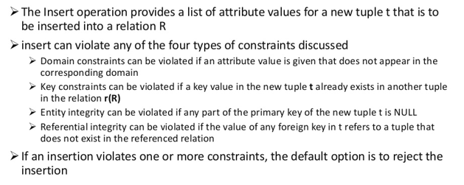
Constraint Violation on Insert Operation

Slide 57
Insert operation and handle violation
Some more egs.
domain constraint violation: some attribute value is not of correct domain
entity integrity violation: key of new tuple is null
key constraint violation: key of new tuple is same as existing one
referential integrity violation: foreign key of new tuple refers to non-existent tuple
How to handle insert operation violation?
Ways of dealing with it: reject the attempt to insert!
Or
give user opportunity to try again with different attribute values.

Slide 58
Insert operation and handle violation
■ Operation:
Insert <‘Cecilia’, ‘F’, ‘Kolonsky’, NULL, ‘1960-04-05’, ‘6357 Windy Lane, Katy,
TX’, F, 28000, NULL, 4> into EMPLOYEE.
Result: This insertion violates the entity integrity constraint (NULL for the
primary key Ssn), so it is rejected.
■ Operation:
Insert <‘Alicia’, ‘J’, ‘Zelaya’, ‘999887777’, ‘1960-04-05’, ‘6357 Windy Lane, Katy,
TX’, F, 28000, ‘987654321’, 4> into EMPLOYEE.
Result: This insertion violates the key constraint because another tuple with
the same Ssn value already exists in the EMPLOYEE relation, and so it is
rejected.
■ Operation:
Insert <‘Cecilia’, ‘F’, ‘Kolonsky’, ‘677678989’, ‘1960-04-05’, ‘6357 Windswept,
Katy, TX’, F, 28000, ‘987654321’, 7> into EMPLOYEE.
Result: This insertion violates the referential integrity constraint specified on
Dno in EMPLOYEE because no corresponding referenced tuple exists in
DEPARTMENT with Dnumber = 7
■ Operation:
Insert <‘Cecilia’, ‘F’, ‘Kolonsky’, ‘677678989’, ‘1960-04-05’, ‘6357 Windy Lane,
Katy, TX’, F, 28000, NULL, 4> into EMPLOYEE.
Result: This insertion satisfies all constraints, so it is acceptable

Slide 59
DELETE Operations and constraint violations on Relations

Slide 60
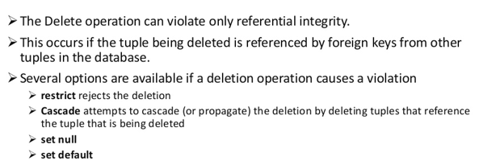
Constraint Violation on Delete Operation

Slide 61
Delete operation
referential integrity violation: a tuple referring to the deleted one exists.
Three options for dealing with it:
Reject the deletion
Attempt to cascade (or propagate) by deleting any referencing tuples (plus those that reference them, etc., etc.)
modify the foreign key attribute values in referencing tuples to null or to some valid value referencing a different tuple

Slide 62
Delete operations and constraint violations
■ Operation:
Delete the WORKS_ON tuple with Essn = ‘999887777’ and Pno = 10.
Result: This deletion is acceptable and deletes exactly one tuple.
■ Operation:
Delete the EMPLOYEE tuple with Ssn = ‘999887777’.
Result: This deletion is not acceptable, because there are tuples in
WORKS_ON that refer to this tuple. Hence, if the tuple in EMPLOYEE is
deleted, referential integrity violations will result.
■ Operation:
Delete the EMPLOYEE tuple with Ssn = ‘333445555’.
Result: This deletion will result in even worse referential integrity violations,
because the tuple involved is referenced by tuples from the EMPLOYEE,
DEPARTMENT, WORKS_ON, and DEPENDENT relations

Slide 63
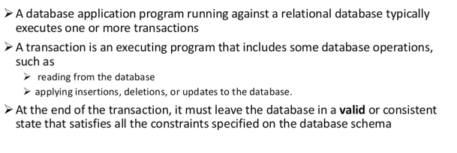
Constraint violation and Transaction concept

Slide 64
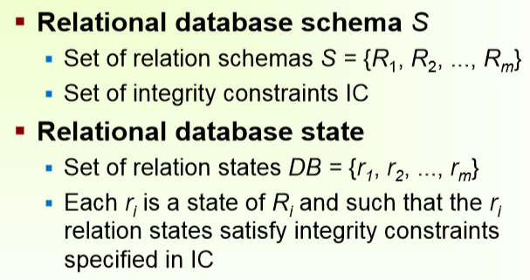
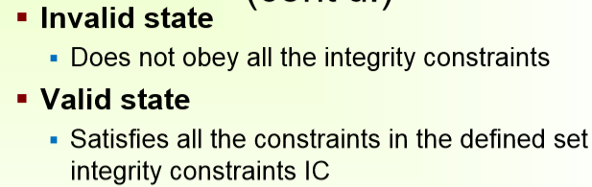
Ralational DB and Relational DB schemas

Slide 65
In-Class Exercise
Consider the following relations for a database that keeps track of student enrollment
in courses and the books adopted for each course:
STUDENT(SSN, Name, Major, Bdate)
COURSE(Course#, Cname, Dept)
ENROLL(SSN, Course#, Quarter, Grade)
BOOK_ADOPTION(Course#, Quarter, Book_ISBN)
TEXT(Book_ISBN, Book_Title, Publisher, Author)
Draw a relational schema diagram specifying the foreign keys for this schema.

Slide 66
THANKS

